Slide 1

MAJOR PROJECT PRESENTATION
Image Forgery Detection using CNN and ELA
UNDER THE GUIDANCE OF – Dr. Anuja Dixit

Slide 2
Team MEMBERS CSE-6D Group 10
1. VIPUL VIBHAS SINGH(20214085)
2. Vikas kumar Patel(20214084)
3. Seemant Singh(20214192)
4. SANGRAM SINGH(20214231)

Slide 3
CONTENTs
INTRODUCTION
OBJECTIVE
Proposed work
Model evaluation
Result analysis
Conclusion
Future scope
references

Slide 4
INTRODUCTION
In today's digital world, images play a crucial role in communication and media. However, with the advancement of technology, it's become easier to edit and manipulate images.
These edited images, called "forged images," can be used to spread false information, commit fraud, or mislead people. Therefore, detecting such image forgery has become crucial.
This introduction explores how technology can be leveraged to detect and combat the growing threat of forged images, with the ultimate goal of promoting transparency, honesty, and a more engaged and discerning public.

Slide 5
The Objective: Developing Advanced Detection Capabilities
By applying deep learning technique, we aim to develop robust model capable of accurately identifying and classifying forged images.
1. Leveraging Deep Learning
2. Extracting Meaningful Features
Through the use of Error Level Analysis (ELA), we can extract meaningful features from images by highlighting differences in compression levels, which can help distinguish authentic images from manipulated or forged content.
3. Enhancing Reliability
Our goal is to create an advanced forged images detection system that can effectively identify
and debunk tampered images, thereby enhancing the reliability of image content available.

Slide 6
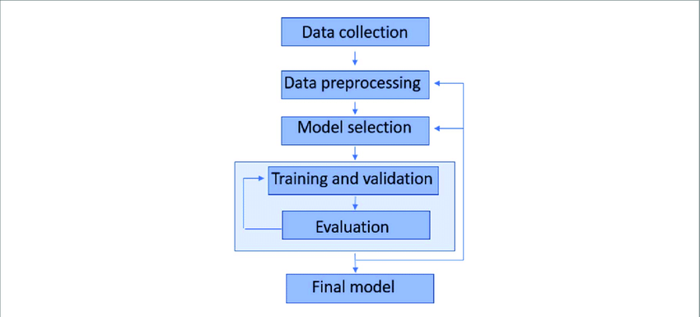
The Proposed Approach
1
Data Collection and Transformation
This includes collecting the necessary dataset, and preparing the image data into a format suitable for machine learning algorithm.
2
Model Training
Three distinct machine learning models will be trained and evaluated: Logistic Regression, Decision Tree Classifier, and Random Forest Classifier.
Each model will be trained on the preprocessed dataset, leveraging ELA to capture the importance of visual features.
3
Model Evaluation and Deployment
We will examine the Loss vs. Epoch and Accuracy vs. Epoch graphs to evaluate the model's performance.
The performance of the trained model will also be assessed using various other metrics, such as accuracy, precision, recall, and F1-score.

Slide 7
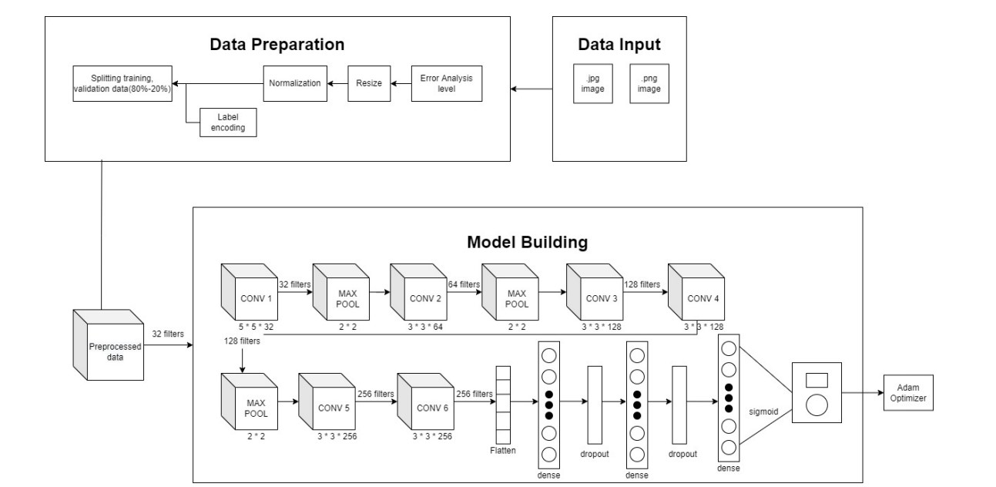
Fig 1 : Flowchart for Image Forgery Detection

Slide 8
About the Dataset
The CASIA Image Forgery Detection Dataset is a widely-used resource for identifying fake or altered images.
CASIA Dataset includes both authentic, untouched images and manipulated ones created using techniques like splicing, retouching, and adding fabricated details, providing a robust foundation for research in forgery detection.
The dataset at hand is unlabelled and is organized into two distinct folders, containing real and forged images.
There are about 7,396 real images and 5,134 forged images present in the dataset.

Slide 9
Error Level Analysis
What is ELA?
Error Level Analysis (ELA) is a technique used to identify tampered or forged regions in digital images.
By comparing the differences between an original image and a re-saved version of it (at a reduced quality), ELA helps highlight areas where manipulation has likely occurred.
Forged regions often show up as discrepancies in the error levels when compared to the rest of the image.
How ELA Detects Forgeries:
Real Images: Typically, real images will show consistent error levels throughout the image after re-saving.
Forged Images: Tampered or forged parts of the image will often show a higher ELA value due to mismatched compression characteristics. These discrepancies indicate possible manipulations, such as image splicing, copy-move, or cloning.

Slide 10
Model Training: Sequential CNN
Input Layer: The image is fed into the network.
Convolution Layers: Extract basic features like edges and textures.
Max Pooling Layers: Reduce dimensions by keeping the most important features.
Additional Convolution
and Pooling: Detect more complex patterns.
Dropout Layers: Prevent overfitting by randomly disabling some neurons during training.
Flatten Layer: Convert feature maps into a one-dimensional vector.
Dense Layers: Learn abstract relationships for classification.
Output Layer: Using a sigmoid activation, outputs a probability (real or forged).

Slide 11
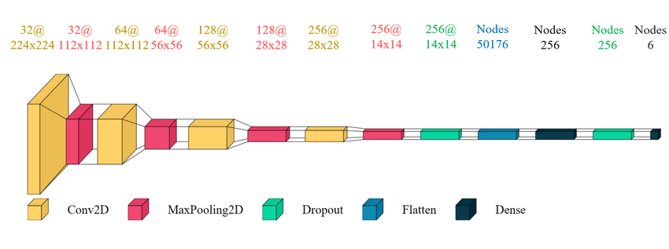
Model Training: Sequential CNN
Fig 2 : Sequential CNN

Slide 12
Why Sequential CNN?
Simplicity and Efficiency
Sequential CNN is easy to implement and requires fewer resources compared to complex models like ResNet or Vision Transformers.
Tailored for Binary Classification
Specifically designed for real vs. forged image classification tasks.
Other models (e.g., GANs) are more complex and not necessary for a binary task, making Sequential CNN more efficient.
Efficiency for Real-time Applications
Sequential CNN is faster in both training and inference, making it more suitable for real-time forgery detection.
Complex models, though powerful, are slower and resource-intensive, which may not be ideal for practical deployment.
Reduced Overfitting
Sequential CNN can be effectively trained without overfitting when using techniques like dropout or data augmentation.
More complex models may have a higher tendency to overfit, especially with smaller datasets.
Generalization Ability
Sequential CNN excels at learning general features and can easily generalize to unseen forgeries.

Slide 13
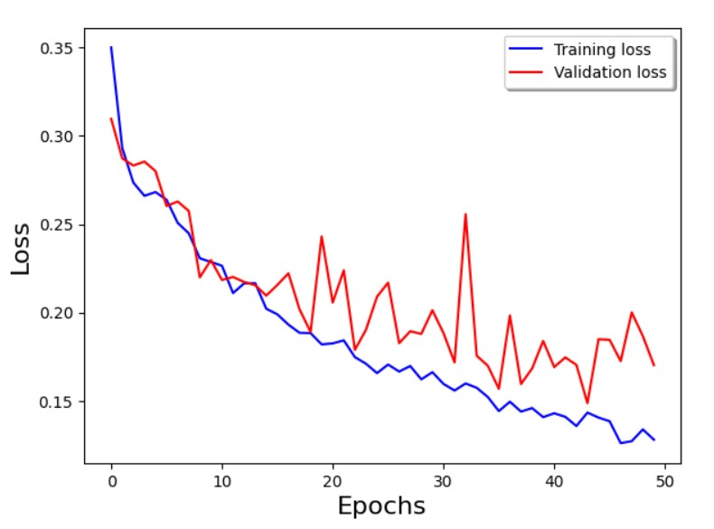
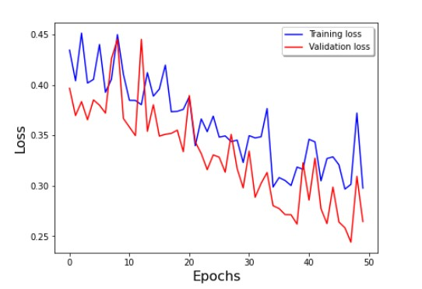
Model Evaluation: Loss v/s Epochs
Fig 3 : Proposed Model
Fig 4 : FIDAC-Model
In FIDAC, the training and validation loss show a relatively slower convergence, with some fluctuations, indicating slight over-fitting or instability in validation performance as epochs progress.
In comparison, in proposed model the loss decreases more steadily with fewer spikes in validation loss, suggesting better stability and generalization.

Slide 14
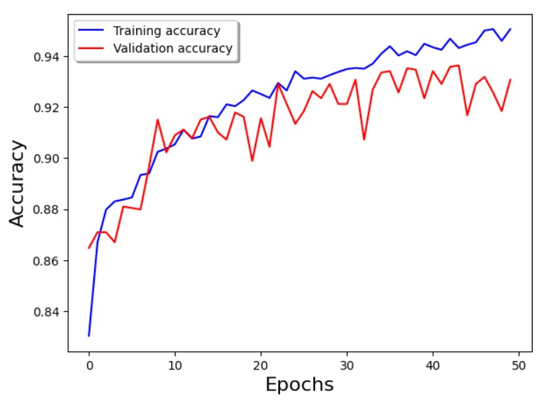
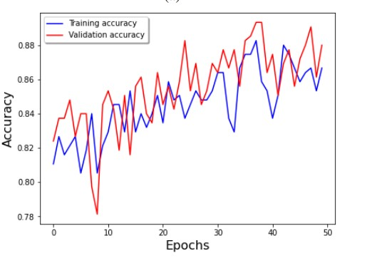
Model Evaluation: Accuracy v/s Epochs
Fig 5 : Proposed Model
Fig 6 : FIDAC-Model
In FIDAC, training and validation accuracy improve over epochs but exhibit significant fluctuations in validation accuracy, highlighting possible inconsistency during validation.
While we can see that proposed model demonstrates smoother and more stable accuracy curves. Training accuracy consistently improves, and validation accuracy aligns closely, indicating better generalization.

Slide 15
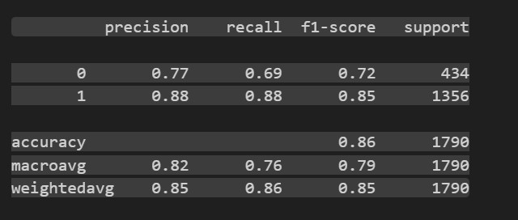
Model Evaluation
Fig 7 : Performance Metrics
Accuracy: The ratio of correctly predicted instances to the total instances. Formula: (TP + TN) / (TP + TN + FP + FN)
Precision: The ratio of correctly predicted positive observations to the total predicted positive observations. Formula: TP / (TP + FP)
Recall: The ratio of correctly predicted positive observations to the all observations in actual class. Formula: TP / (TP + FN)
F1 Score: The harmonic mean of precision and recall, providing a balance between the two. Formula: 2 * (Precision * Recall) / (Precision + Recall)

Slide 16
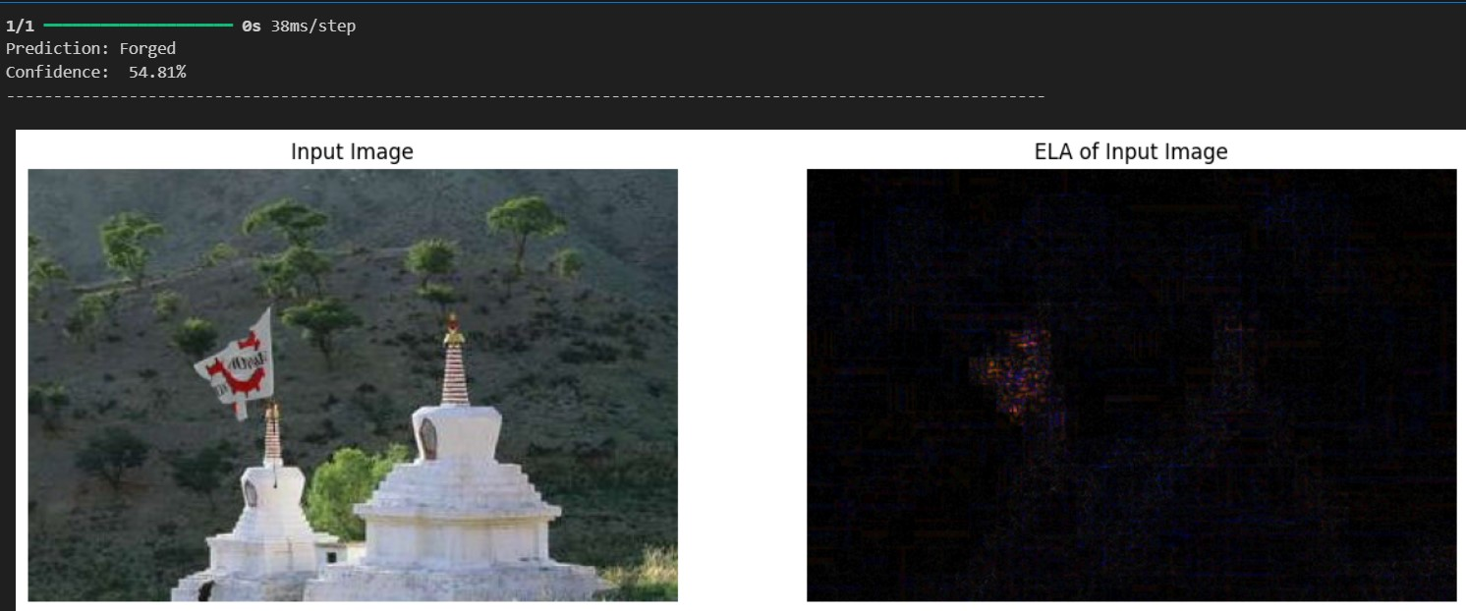
Testing the model
Fig 8 : Predicting the image content

Slide 17
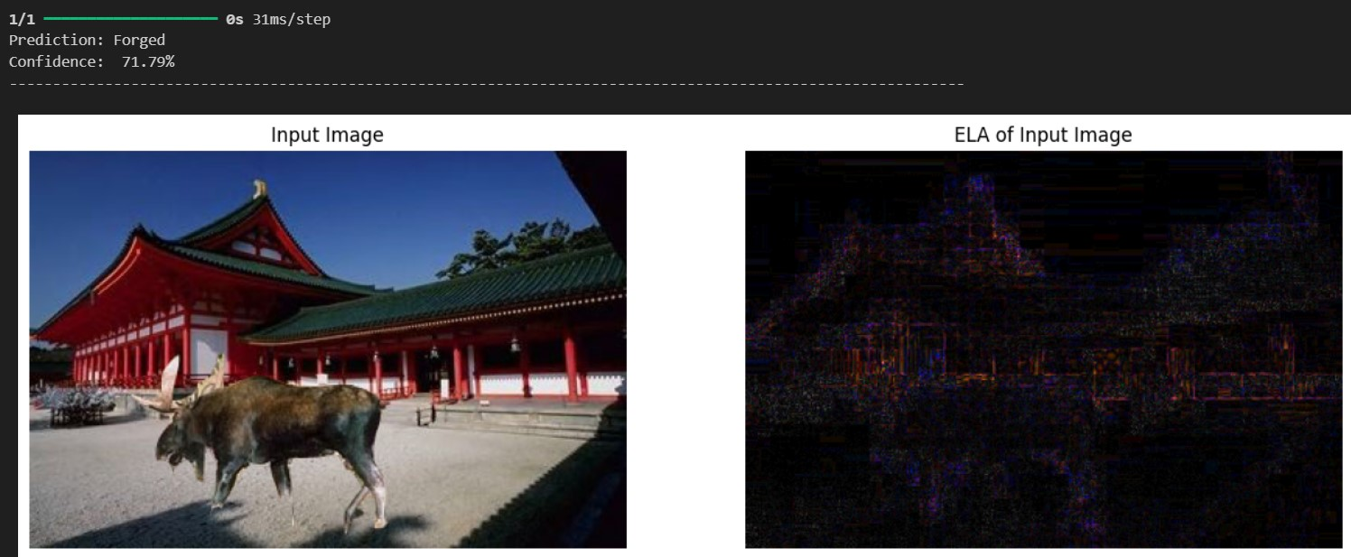
Testing the model
Fig 9 : Predicting the image content

Slide 18
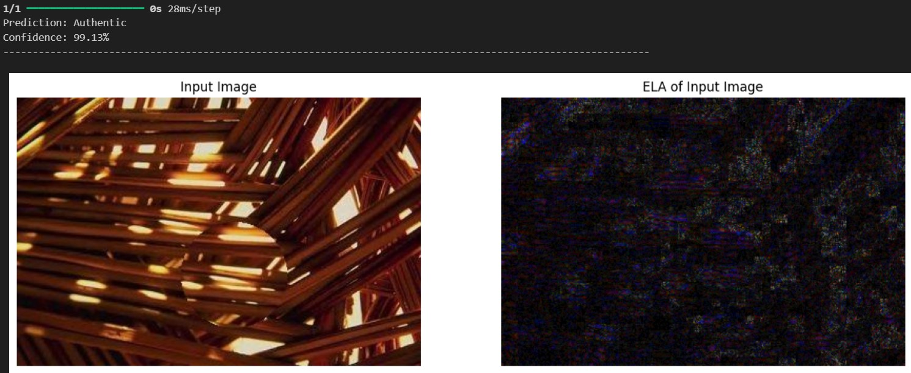
Testing the model
Fig 10 : Predicting the image content

Slide 19
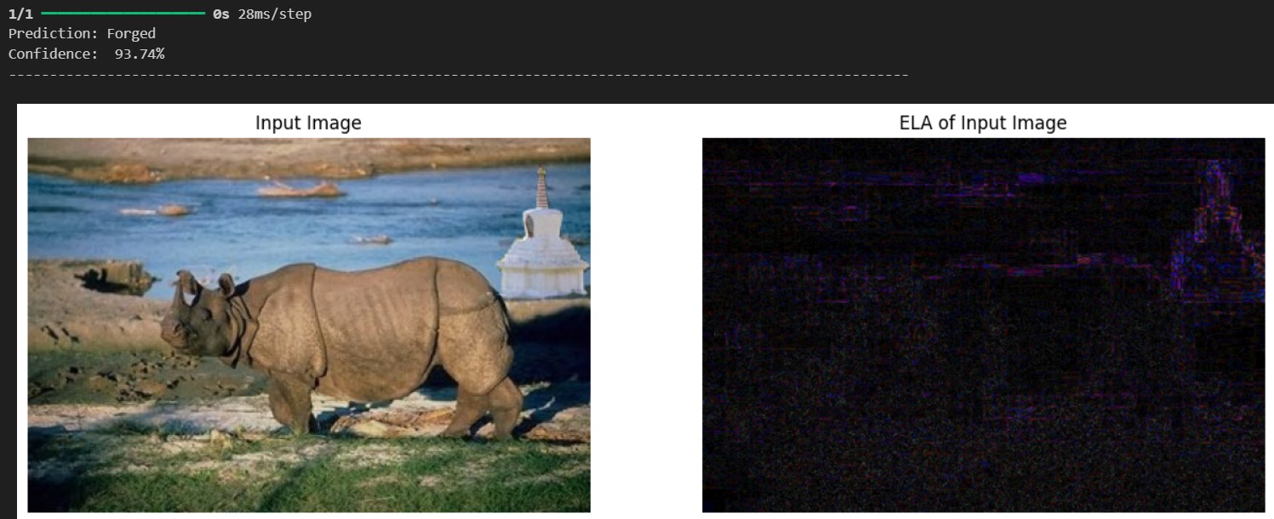
Testing the model
Fig 11 : Predicting the image content

Slide 20
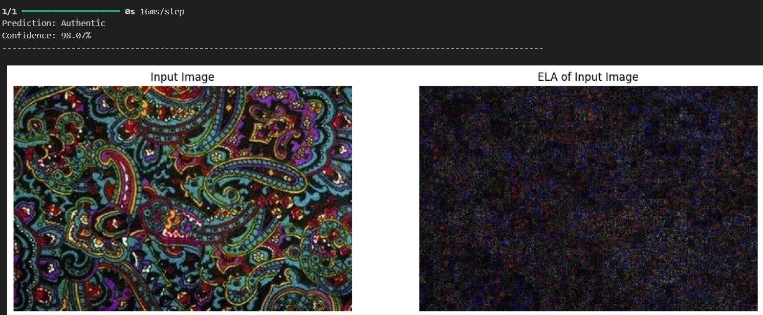
Testing the model
Fig 12 : Predicting the image content

Slide 21
Conclusion
The model achieves 86% accuracy, excelling in identifying real images (recall: 0.88) but struggles with forged ones (recall: 0.69).
Class 0’s(Forged image) lower recall suggests the need for more data, tuning, or regularization to improve forged image detection.
With Epochs, the loss decreases more steadily with fewer spikes in validation loss, suggesting better stability and generalization.
Accuracy v/s Epochs graph demonstrates smoother and more stable accuracy curves. Training accuracy consistently improves, and validation accuracy aligns closely, indicating better generalization.

Slide 22
Future Directions
1
More Diverse Dataset
2
Synthetic Data Generation
Expanding the dataset with diverse manipulation techniques and varying image qualities improves the model's accuracy and robustness.
Using GANs to create forged images increases dataset diversity, helping the model detect more subtle manipulations effectively.
3
Practical Application
4
Deploy models in organizations to detect forged images, ensuring trust and preventing the spread of false information.

Slide 23
References
M. Kunj and V. Tyagi, "Image forgery detection: Survey and future directions", Data Engineering and Applications, pp. 163-194, 2019.
B. Bayar and M. C. Stamm, "A Deep Learning Approach to Universal Image Manipulation Detection Using a New Convolutional Layer", Proceedings of the 4th ACM Workshop on Information Hiding and Multimedia Security, 2016.
I. B. Sudiatmika, F. Rahman, T. Trisno and S. Suyoto, "Image forgery detection using error level analysis and deep learning", TELKOMNIKA (Telecommunication Computing Electronics and Control), vol. 17, no. 2, pp. 653, 2018.
A. Kuznetsov, "Digital image forgery detection using deep learning approach", Journal of Physics: Conference Series, vol. 1368, pp. 032028, 2019.
N Qurat-ul-ain, A. Irtaza Nida and N. Ilyas, "Forged face detection using ELA and Deep Learning Techniques", 2021 International Bhurban Conference on Applied Sciences and Technologies (IBCAST), 2021.
S. Pawar, G. Pradhan, B. Gaurangi and S. Bhutad, "FIDAC- Forged Im- ages Detection And Classification," IEEE Dataport, 2022. [Online]. Available: https://dx.doi.org/10.21227/4det-6512.
A. H. Khalil, A. Z. Ghalwash, H. A. -G. Elsayed, G. I. Salama and H. A. Ghalwash, "Enhancing Digital Image Forgery Detection Using Transfer Learning," in IEEE Access, vol. 11, pp. 91583-91594, 2023, doi: 10.1109/ACCESS.2023.3307357

Slide 24
THANK YOU!!

